Slide 1
THE JOURNEY OF AN ARCH IN ITS CREATION
GFRC FACADES
MUMBAI

Slide 2
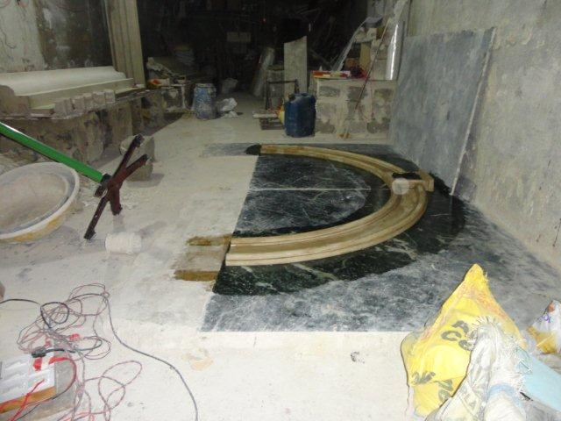
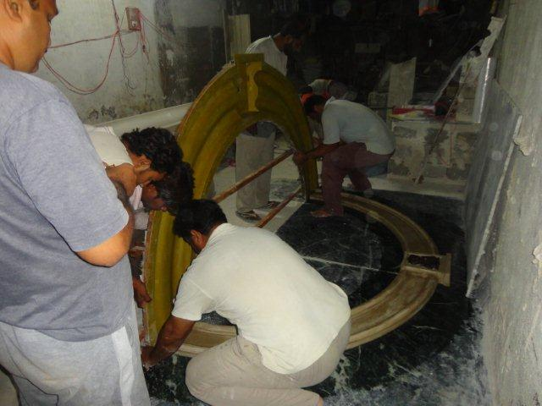
THE JOURNEY OF CREATING AN ARCH
THE PATTERN IN POP
PREPERATION TO MAKE A RUBBER MOLD

Slide 3
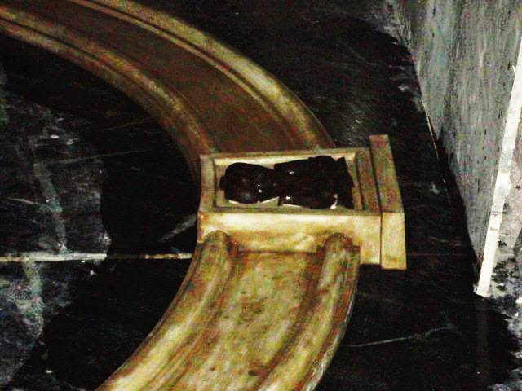
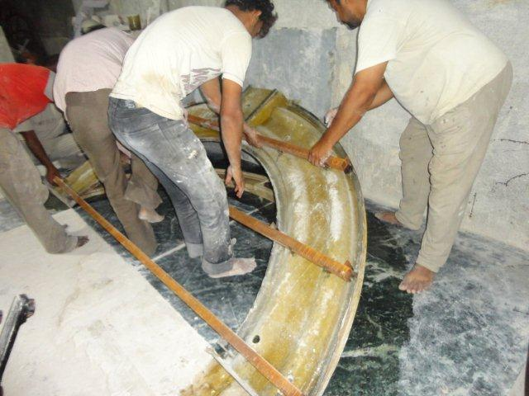
THE ARCH
THE PATTERN IN POP
PLACING OF BACK MOLD ON THE PATTERN

Slide 4
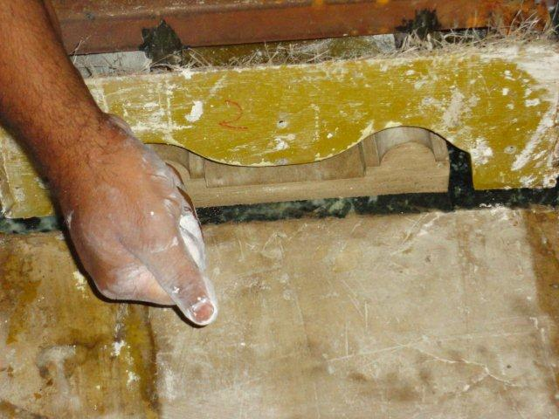
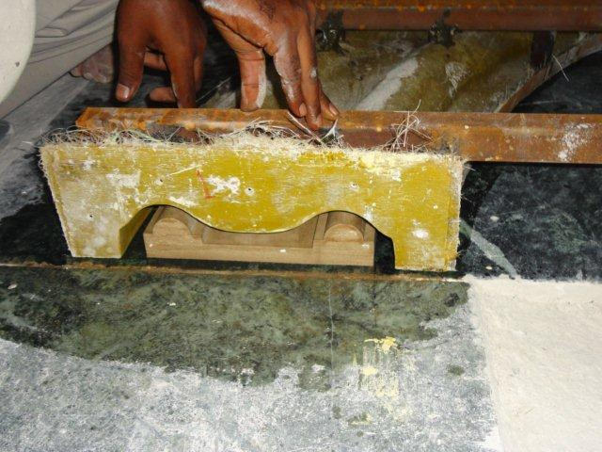
THE ARCH
CHECKING THE GAP BETWEEN THE FRP BACK MOLD & THE POP PATTERN
THE CLEAR GAP FOR THE FREE FLOW OF THE RUBBER

Slide 5
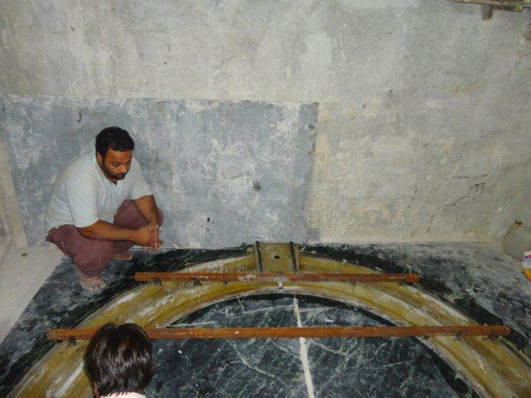
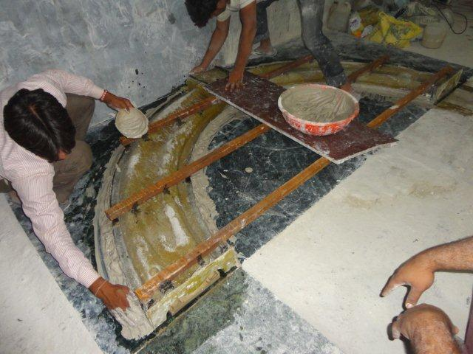
THE ARCH
SEALING OF THE EDGES TO AVOID THE RUBBER FLOWING OUT
BACK MOLD LAID ONTO THE POP PATTERN

Slide 6
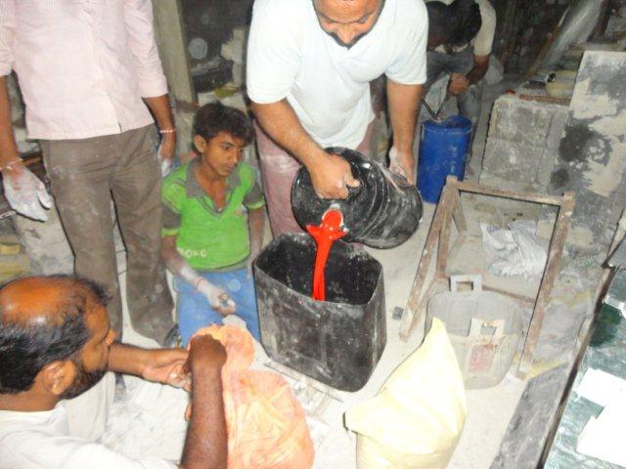
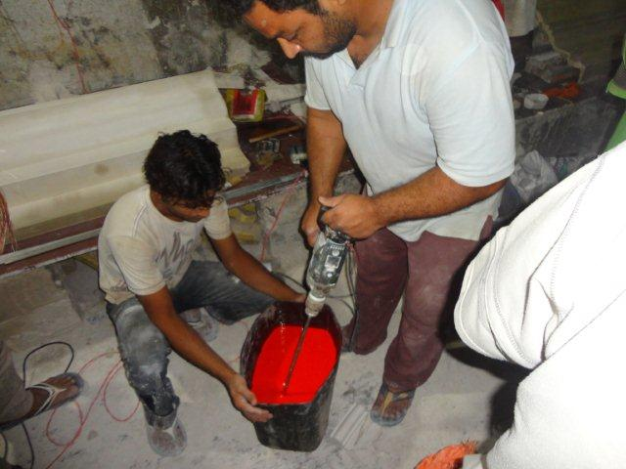
THE RUBBER MIXTURE
THE WEIGHING OF THE RUBBER MIX
THE MIXING OF THE RUBBER SOLUTION

Slide 7
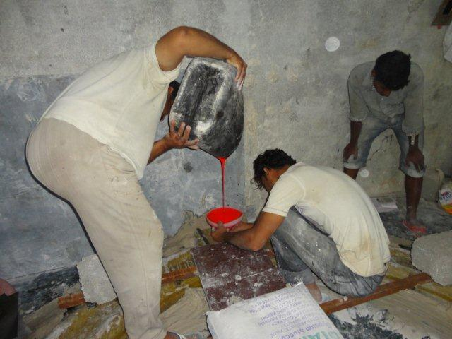
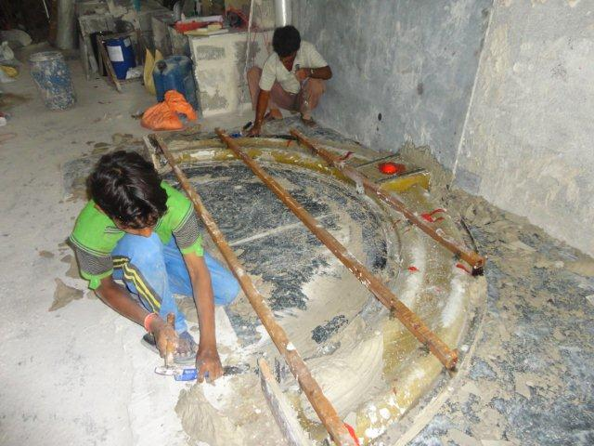
THE PROCESS OF CREATING A MOLD IN RUBBER
POURING OF RUBBER MIX INTO THE MOLD
REMOVAL OF THE JOINT SEALING

Slide 8
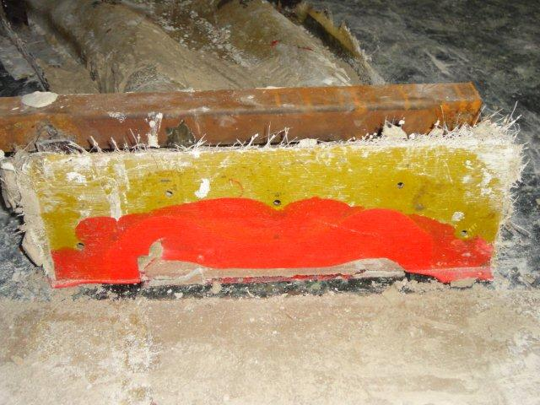
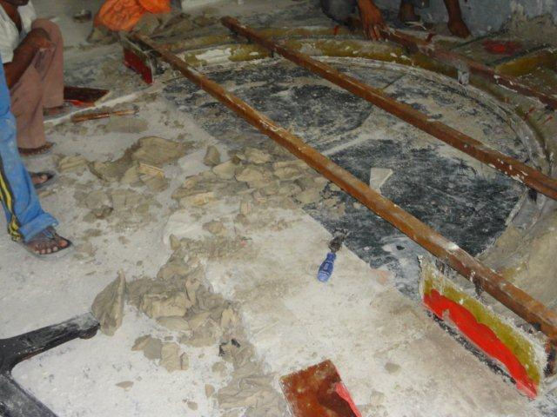
THE SET RUBBER SOLUTION TAKEN ITS SHAPE AS PER THE PATTERN DESIGN OF HE ARCH
THE RUBBER TAKEN ITS SHAPE AS PER THE DESIRED PATTERN
THE BACK MOLD TO BE DEMOLDED FROM ITS POSITION

Slide 9
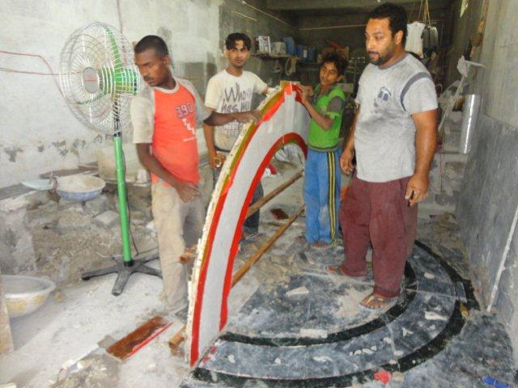
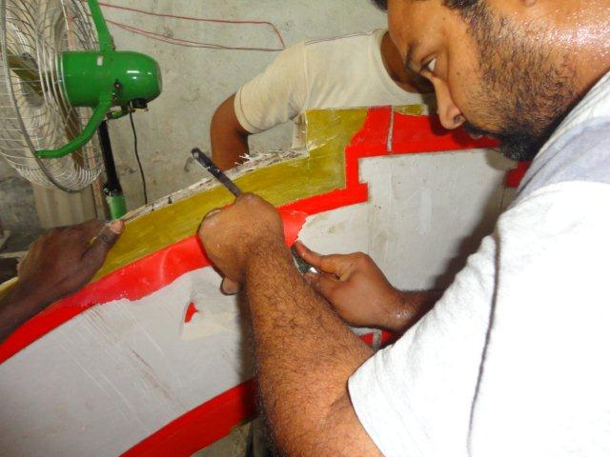
THE DEMOLDING PROCESS
THE RELEASED MOLD
FINISHING OF THE MOLD

Slide 10
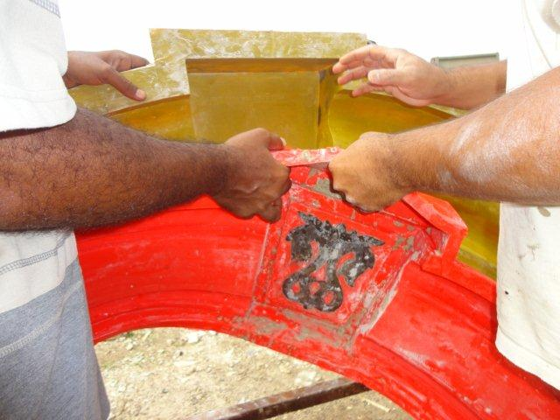
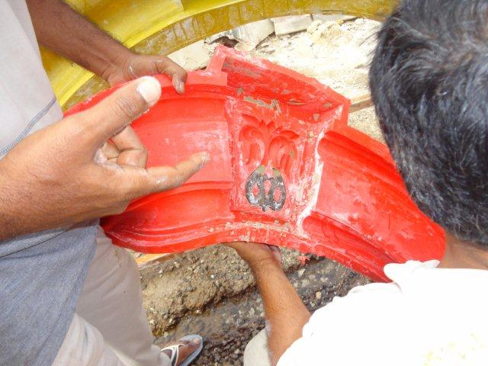
THE CLEANING OF THE RUBBER MOLD
DEMOLDING FROM THE BACK MOLD
WOOD CARVED MOLD BEING RELEASED

Slide 11
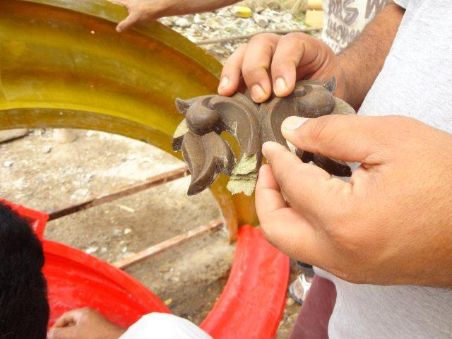
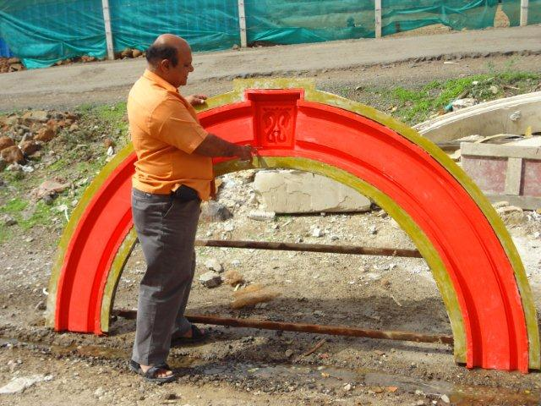
THE FACE MOLD IN RUBBER WITH FRP BACK MOLD
THE RUBBER MOLD WITH BACK MOLD IN FRP
WOOD CARVING KEYSTONE REMOVED

Slide 12
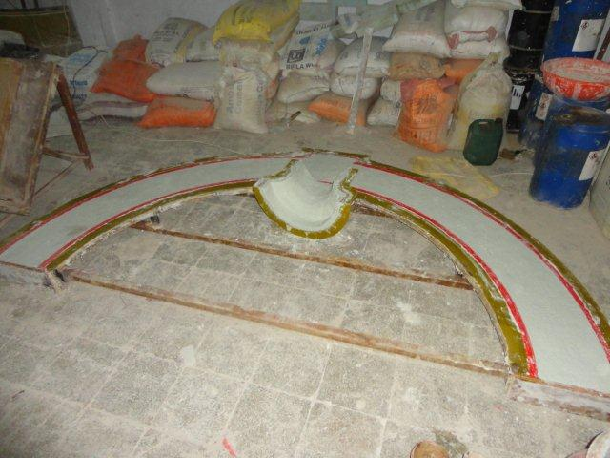
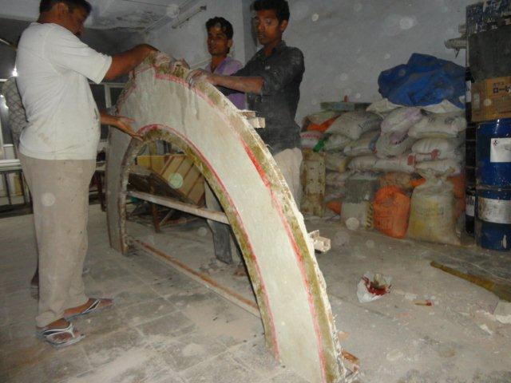
THE CASTING OF ARCH IN GRC
CASTING IN WITH GRC
RELEASING OF THE ARCH FROM ITS MOLD

Slide 13
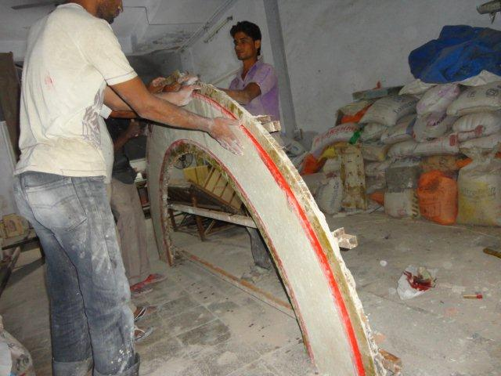
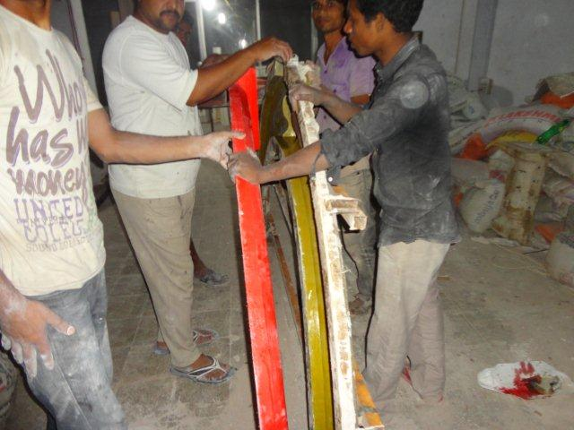
DEMOLDING GRC ARCH ELEMENT
THE RELEASE OF THE FRP MOLD ROM THE RUBBER FACE MOLD
DEMOLDING IN PROCESS

Slide 14
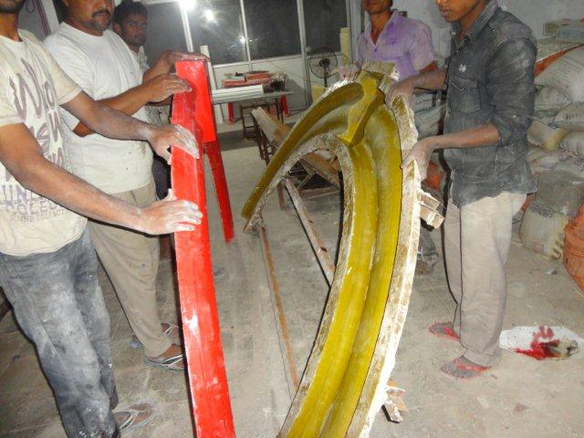
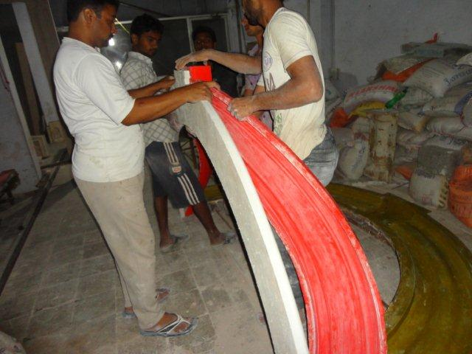
THE DEMOLDING OF GRC ARCH FROM ITS MOLD
RELEASE OF BACK MOLD
ARCH BEING RELEASED FROM THE RUBBER MOLD

Slide 15
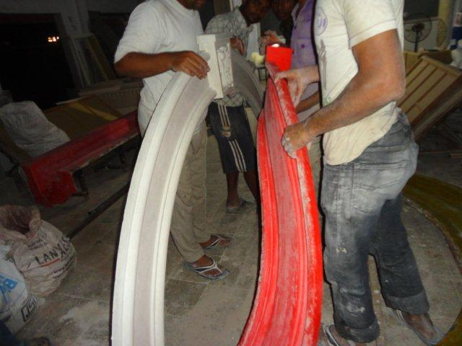
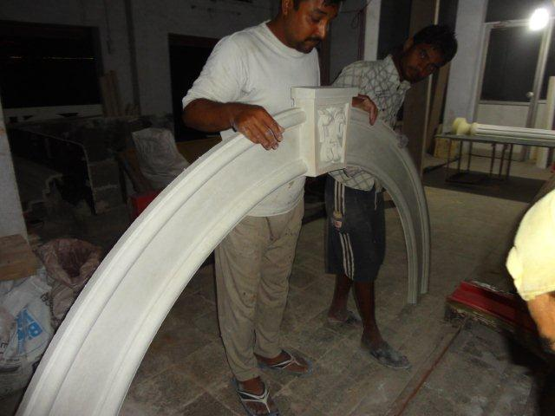
THE ARCH
FINAL RELEASE FROM THE MOLD
THE ARCH DEMOLDED

Slide 16
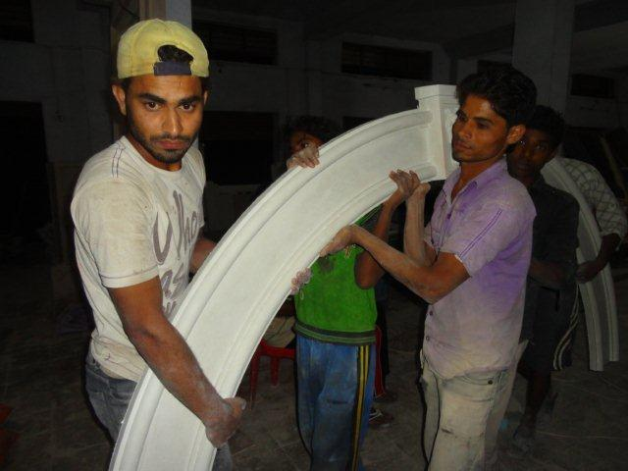
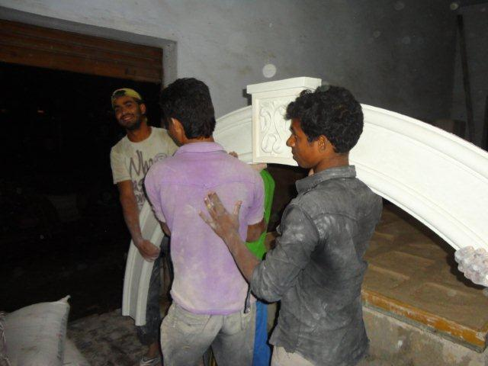
ARCH DEMOLDED BEING SHIFTED
EVERY GRC ELEMENT HAS TO BE CARRIED & SHIFTED FOR WATER CUREING, IN A SPECIFIC WAY OR POSITION, LIFTING IT WITHOUT PROPER KNOWLEDGE .

Slide 17
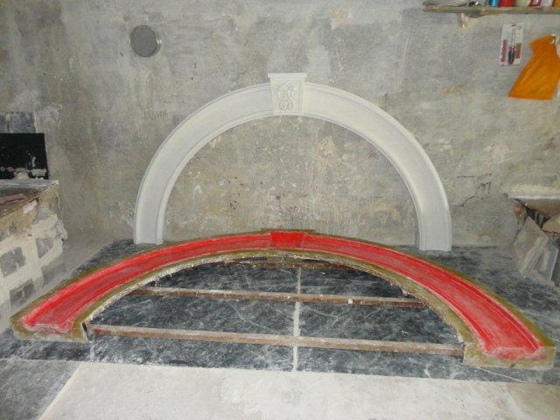
THE MOLD & THE GRC ELEMENT
THIS IS THE EFFORT PUT INTO MAKING OF A RUBBER MOLD
RUBBER MOLDS PROVIDE
BETTER FINISH
MORE NUMBER OF REPEATES
COST 3 TO 4 TIMES MORE THEN A FRP REGULAR MOLD

Slide 18
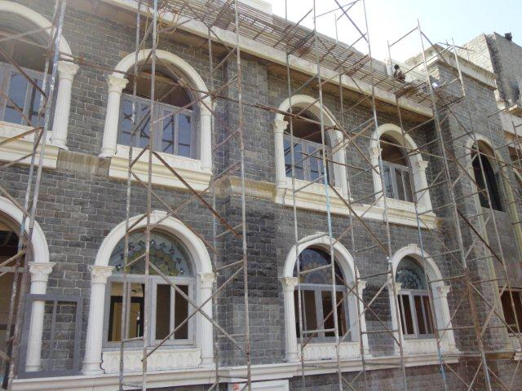
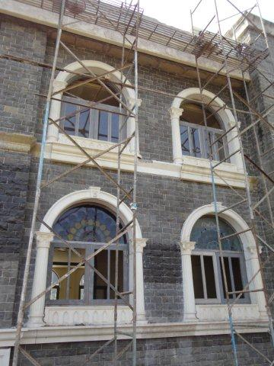
THE ARCH FIXED IN POSITION WITH COLUMNS HOLDING THEM & THE BECORATIVE BASE PANEL & CORNICE BELOW

Slide 19
CONTACT US AT -
GFRC FACADES.
GFRC / GRC, GRG CEILINGS & PANELS, FRP WORKS, HIGH END DECORATIVE & ARCHITECTURAL WORKS & ACOUSTIC SOLUTIONS WITH EXPERTISE IN HOME THEATRES
SRIHARI NILKAR
MUMBAI
Mobile: 09867569395
nilkarsrihari@gmail.com

